Slide 1
Brain Tumor Detection
Casey Patel

Slide 2
Introduction
A brain tumor is considered one of the most aggressive diseases, affecting both children and adults. Brain tumors account for 85 to 90 percent of all primary Central Nervous System (CNS) tumors.
Each year, approximately 11,700 people are diagnosed with a brain tumor.
The 5-year survival rate for individuals with a cancerous brain or CNS tumor is about 34 percent for men and 36 percent for women.

Slide 3
Problem Statement
The detection and classification of brain tumors, which account for a significant portion of primary Central Nervous System (CNS) tumors, present a critical challenge due to their complexity and the substantial volume of MRI image data generated.
Current manual examination methods are prone to errors, underscoring the need for advanced diagnostic tools to enhance accuracy and improve patient outcomes.
The goal of this project is to analyze MRI images of the brain to accurately determine the presence of tumors and minimize human error in diagnosis.

Slide 4
Dataset
Folder | Description
yes | The folder yes contains 1500 Brain MRI Images that are tumorous
no | The folder no contains 1500 Brain MRI Images that are non-tumorous
The dataset is obtained from Kaggle called Brain Tumor Detection. The dataset contains 3 folders: yes, no and pred.

Slide 5
Data Wrangling
preprocessed MRI brain images for training a Convolutional Neural Network (CNN) model to detect the presence of brain tumors. The main goals of the preprocessing steps were to ensure that the images are in a consistent format and size, and to label them appropriately for use in the model.

Slide 6
Exploratory Data Analysis(EDA)
prepare the preprocessed MRI brain images and their corresponding labels for training a Convolutional Neural Network (CNN) model. It involves shuffling the dataset, creating data generators with augmentation, and generating batches of data for training and validation.
Utilized ImageDataGenerator to create two data generators: train_datagen for training and test_datagen for validation.

Slide 7
I split the preprocessed dataset and corresponding labels into training and testing sets using an 80-20 split ratio. By specifying a random_state, the split is made reproducible. The training set (X_train, y_train) was used to train the CNN model, while the test set (X_test, y_test) was used to evaluate the model's performance.
Then, Normalized the image data by scaling pixel values to the range [0, 1] which ensures that the CNN model receives inputs that are consistent in scale and numerically stable.
Finally, converted binary class labels into one-hot encoded vectors, which is essential for training a CNN model with categorical cross-entropy loss.

Slide 8
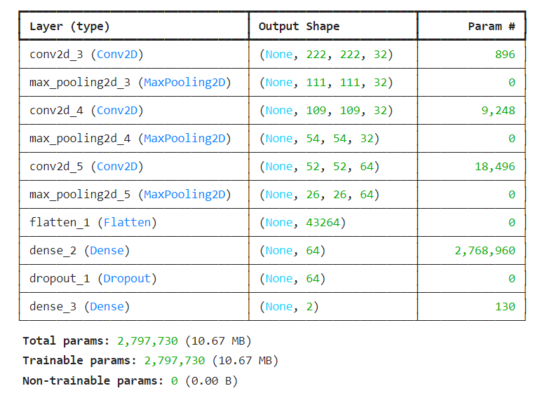
Machine Learning Model (CNNs)
Input Layer: Accepts images of shape 224.
Convolutional Layers:
3 Conv2D layers with filters of size 3x3, ReLU activation, and
He uniform kernel initializer.
MaxPooling2D layers with pool size of 2x2 after each Conv2D
layer to reduce spatial dimensions.
Fully Connected Layers:
A Flatten layer to convert 2D matrices to 1D vectors.
A Dense layer with 64 neurons and ReLU activation.
A Dropout layer with 50% dropout rate to mitigate overfitting.
An Output layer with 2 neurons and softmax activation for
binary classification.
Compilation:
Loss function: Categorical cross-entropy.
Optimizer: Adam.
Metric: Accuracy.
Usage:
Suitable for binary image classification tasks, providing an end-to-end model architecture from input images to class probabilities.

Slide 9
employed EarlyStopping to prevent overfitting by stopping the training when no further improvement in the training loss is observed, thereby saving computational resources and time.
Also, utilized ReduceLROnPlateau dynamically to adjust the learning rate when the validation loss plateaus, ensuring more refined weight updates and potentially leading to better model performance.
These mechanisms together help in creating a robust and efficient CNN model for brain tumor detection.

Slide 10
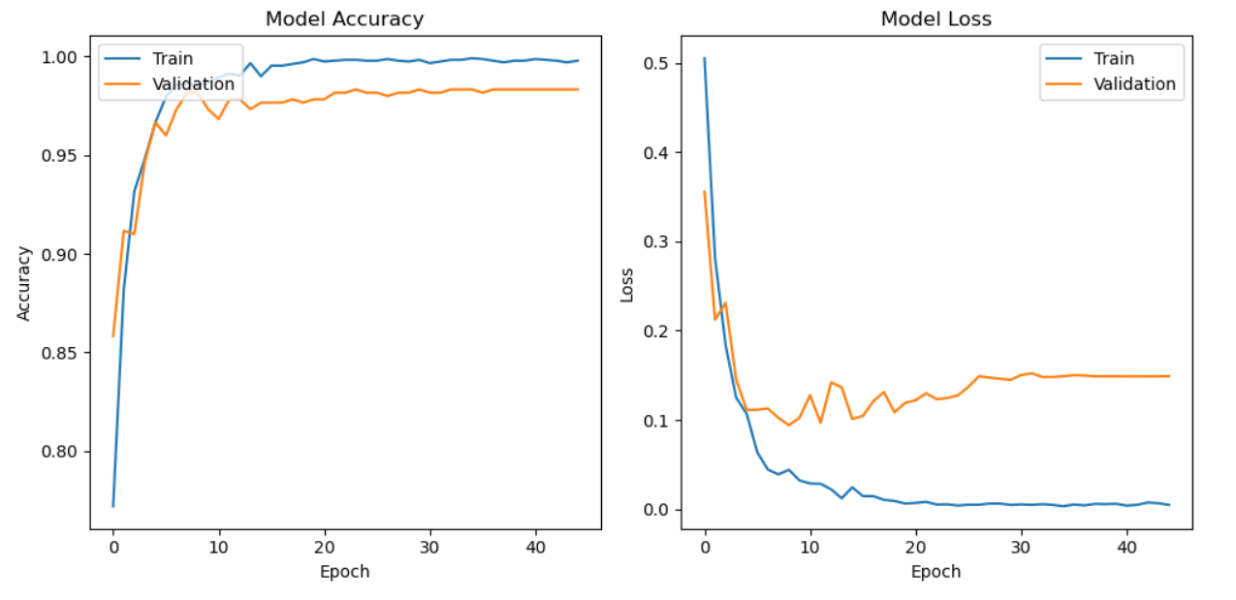
Visualizing accuracy and loss of the model
Next, visualized the training history of a Convolutional Neural Network (CNN) model by plotting the accuracy and loss for both the training and validation datasets over the epochs.
The high accuracy of the model, around 98%, indicates a robust and well-trained AI system that can significantly improve brain tumor detection.

Slide 11
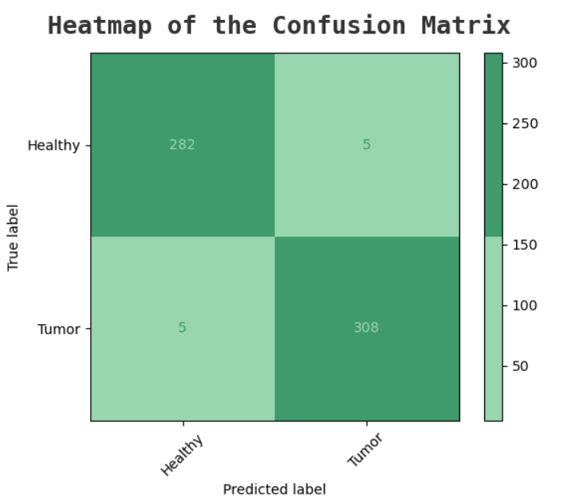
Heatmap of confusion Matrix
visualized the performance of a machine learning model(CNNs) using a confusion matrix plotted as a heatmap.
As we can see in the figure 98% of the time model predicts correct image.

Slide 12
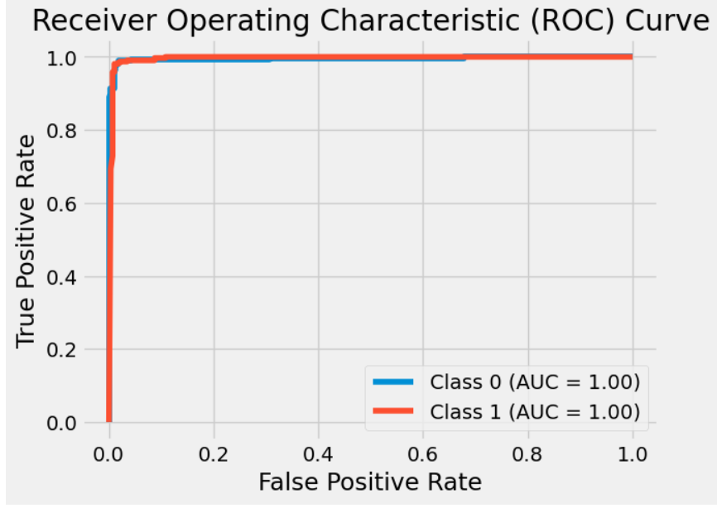
Next computed and plotted the Receiver Operating Characteristic (ROC) curve and Area Under the Curve (AUC) score for a multi-class classification model.
The ROC curve is curving near the point (0,1), it signifies that the model has excellent discriminatory power, making it a robust and accurate classifier for the given task.

Slide 13
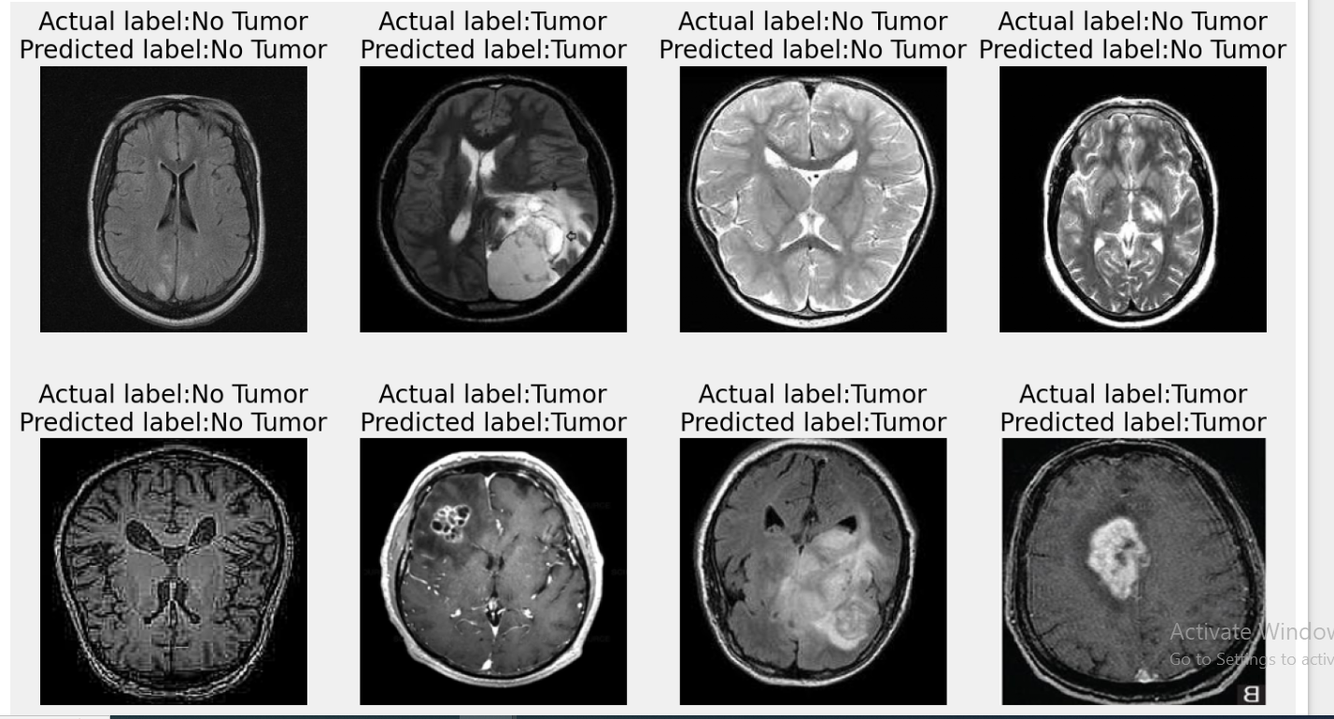
Predicting images
created a function which iterates through the first 16 test images (X_test) of a tumor classification model. For each image, it displays the image itself, along with its actual and predicted labels as titles. This visualization helps in understanding how well the model is performing by comparing its predictions against the ground truth labels.

Slide 14
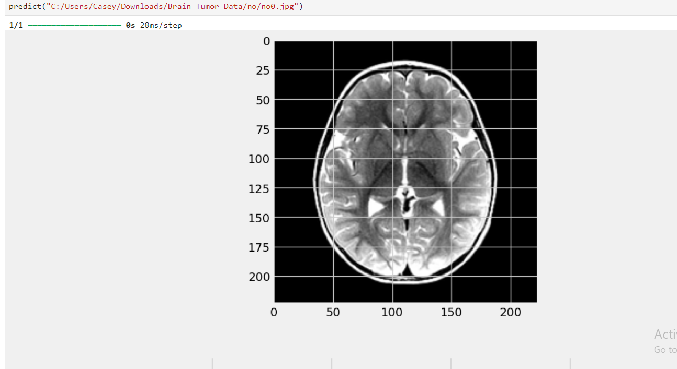
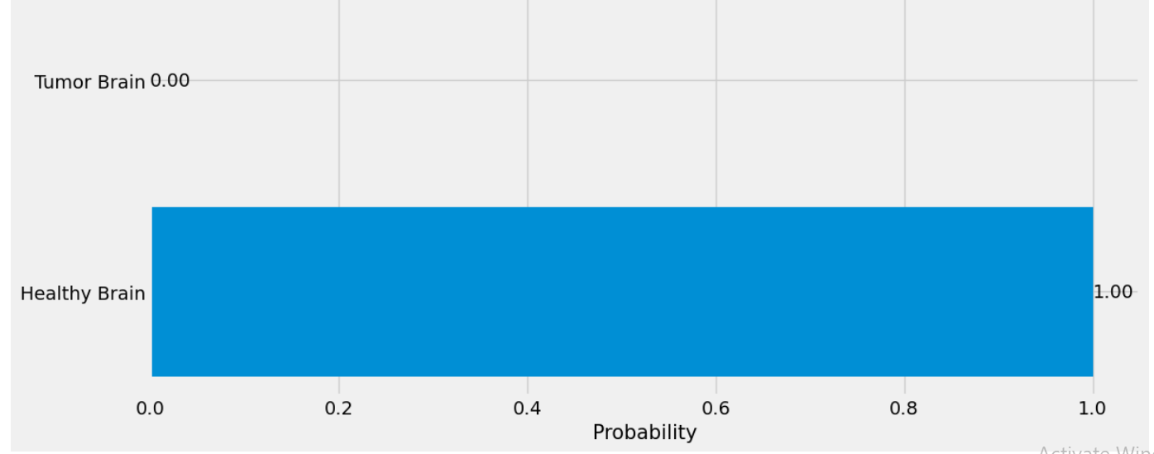
created a function Predict to predict the images.
Defines the class labels that the model will predict. In this case, it distinguishes between a "Healthy Brain" and a "Tumor Brain".
Model predicted correct image.

Slide 15
Conclusion
The predict function effectively demonstrates the capability of a pre-trained model to classify brain images as either "Healthy Brain" or "Tumor Brain". By preprocessing the input image and generating a visual representation of the model's predictions, the function provides a user-friendly way to interpret the results. The use of horizontal bar charts helps to clearly communicate the confidence levels of the predictions.

